Slide 1
ECE/CS 552: Memory, ECC and I/O
Boone Severson
Lecture notes based in part on slides created by Joshua San Miguel, Mikko Lipasti, Mark Hill, David Wood, Guri Sohi, John Shen and Jim Smith

Slide 2
Address Translation
VA→PA mapping:
Split VA into virtual page number (VPN) and page offset (POFS)
Translate VPN into physical page number (PPN)
  POFS is not translated
  VA→PA = [VPN, POFS] → [PPN, POFS]
e.g.,
  64KB pages implies 16-bit POFS
  32-bit machine implies 32-bit VA; thus 16-bit VPN
  Maximum 256MB physical memory implies 28-bit PA; thus 12-bit PPN
virtual address[31:0]
[31:16] = VPN
[15:0] = POFS
translate
don’t touch
physical address[27:0]
[27:16] = PPN
[15:0] = POFS

Slide 3

Physical (PIPT) Cache
virtual
TLB
TLB
physical
L1-I cache
L1-D cache
unified I/D L2 cache
main memory
page table

Slide 4
Virt-Indexed Phys-Tagged (VIPT) Cache
virtual
TLB
TLB
L1-I cache
L1-D cache
physical
unified I/D L2 cache
main memory
page table

Slide 5
VIPT Cache
Synonyms: different virtual address → same physical address?
virtual address
TLB
cache indexing in parallel to TLB lookup
way 0
way N-1
way 0
way N-1
physical address
tag |  | tag |  | data |  | data
 | ● ● ● |  |  |  | ● ● ●
hash function
set
tag
HIT?
=
data

Slide 6
VIPT Cache – Synonyms
virtual address
V_{A}
TLB
way 0
way N-1
way 0
way N-1
physical address
tag |  | tag |  | data |  | data
 | ● ● ● |  |  |  | ● ● ●
hash function
set
tag
HIT?
=
data

Slide 7
VIPT Cache – Synonyms
virtual address
V_{A}
TLB
way 0
way N-1
way 0
way N-1
physical address
tag |  | tag |  | data |  | data
 | ● ● ● |  |  |  | ● ● ●
 |  | X |  |  |  | [X]
V_{A} -> X
hash function
set
tag
HIT?
=
data

Slide 8
VIPT Cache – Synonyms
virtual address
V_{B}
TLB
way 0
way N-1
way 0
way N-1
physical address
tag |  | tag |  | data |  | data
 | ● ● ● |  |  |  | ● ● ●
 |  | X |  |  |  | [X]
hash function
set
tag
HIT?
=
data

Slide 9
VIPT Cache – Synonyms
virtual address
V_{B}
synonym problem:
two copies of same physical block!
TLB
way 0
way N-1
way 0
way N-1
physical address
tag |  | tag |  | data |  | data
 | ● ● ● |  |  |  | ● ● ●
 |  | X |  |  |  | [X]
X |  |  |  | [X]
V_{B} -> X
hash function
set
tag
HIT?
=
data

Slide 10
VIPT Cache – Synonyms
virtual address
V_{A}, V_{B}
TLB
way 0
way N-1
way 0
way N-1
physical address
tag |  | tag |  | data |  | data
 | ● ● ● |  |  |  | ● ● ●
 |  | X |  |  |  | [X]
hash function
set
tag
HIT?
=
solution:
map V_{A} and V_{B} to the same set
data

Slide 11
VIPT Cache – Synonyms
But don’t know V_{A} and V_{B} a priori; how to map them to the same set?
virtual address
V_{A}, V_{B}
TLB
way 0
way N-1
way 0
way N-1
physical address
tag |  | tag |  | data |  | data
 | ● ● ● |  |  |  | ● ● ●
 |  | X |  |  |  | [X]
V_{A},V_{B} -> X
hash function
set
tag
HIT?
=
solution:
map V_{A} and V_{B} to the same set
data

Slide 12
VIPT Cache – Synonyms
e.g., Assume 4KB pages. If the physical address of our data is 0x1A318ED4, and virtual addresses V_{A} and V_{B} both map to it, what do we know about V_{A} and V_{B}?
V_{A} = 0x______ED4
V_{B} = 0x______ED4
So then without knowing what V_{A} and V_{B} exactly are, how can we make sure they always map to the same set in our VIPT cache?

Slide 13
Error Correction Codes
Main memory stores a huge number of bits
  Probability of bit-flip becomes significant
  Bit-flips (called soft errors) caused by
    Gamma rays and alpha particles
    Electrical interference
    etc.
  Getting worse with smaller feature sizes
Systems must be protected from soft errors via error correction codes (ECC)

Slide 14
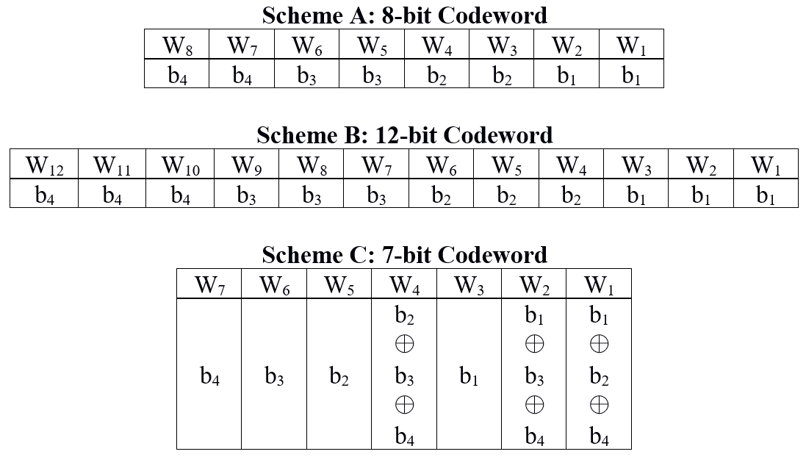
Exercise – ECC

